Slide 1
Tello无人机的SDK开发

Slide 2
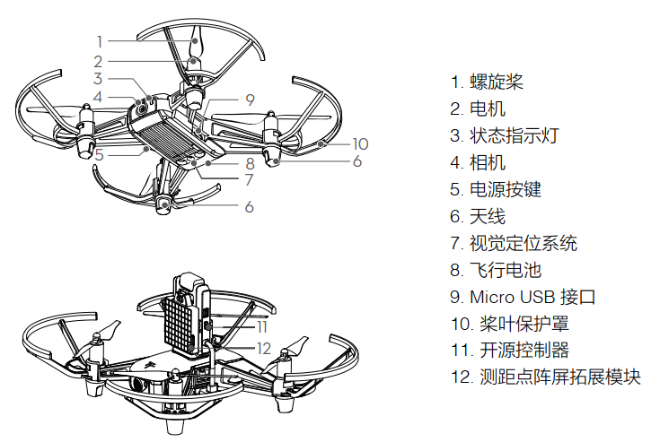
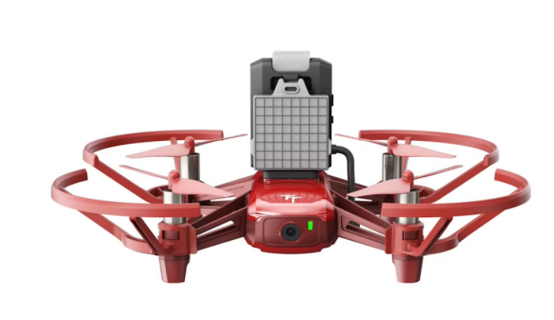
一、功能介绍

Slide 3
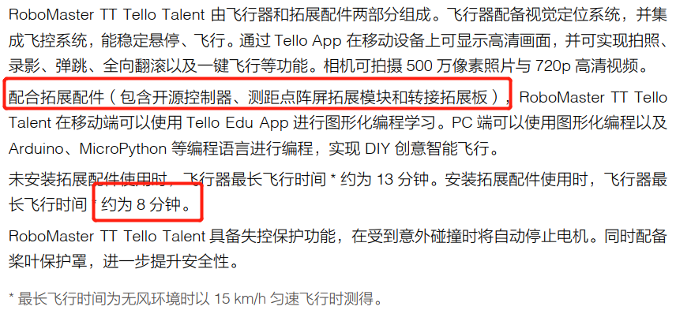

Slide 4
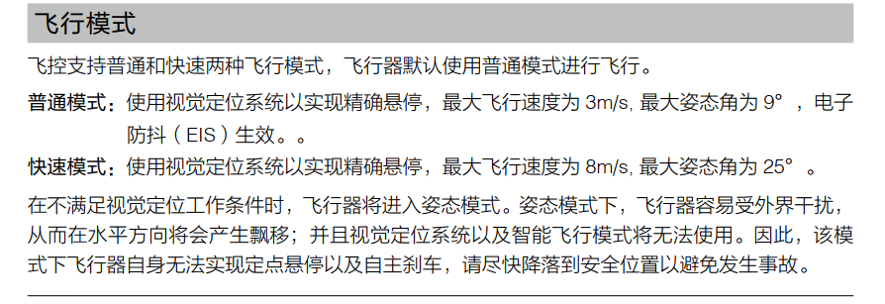

Slide 5
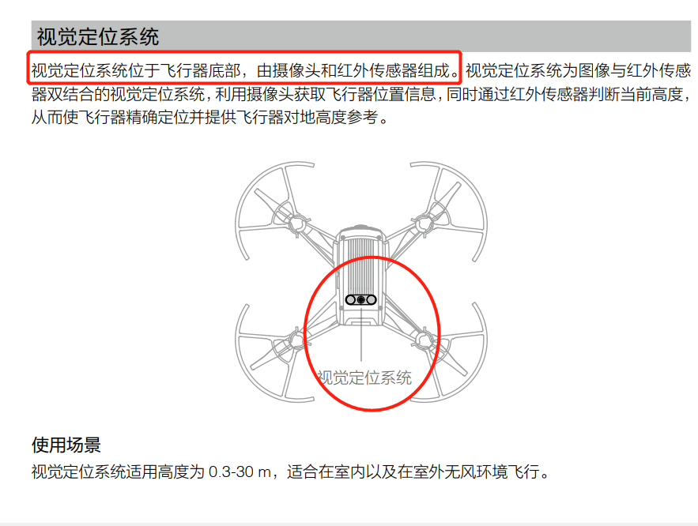

Slide 6
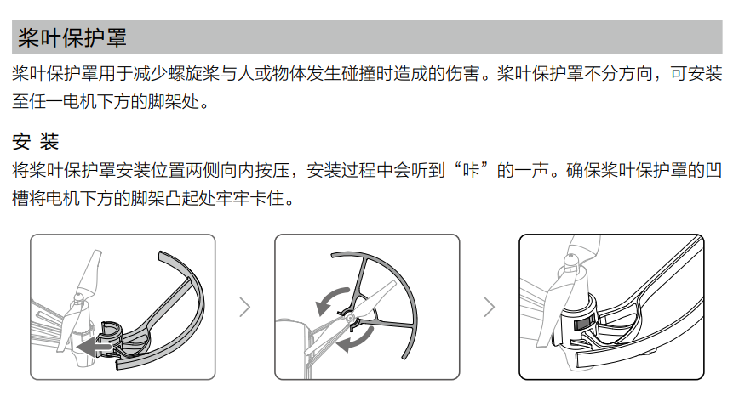
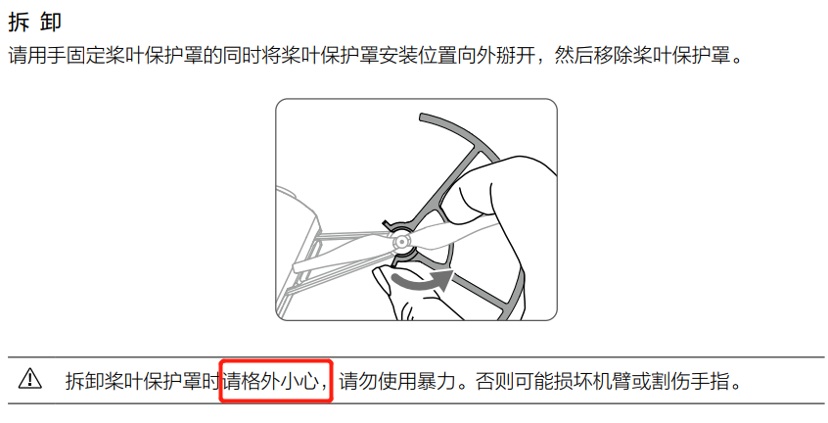

Slide 7
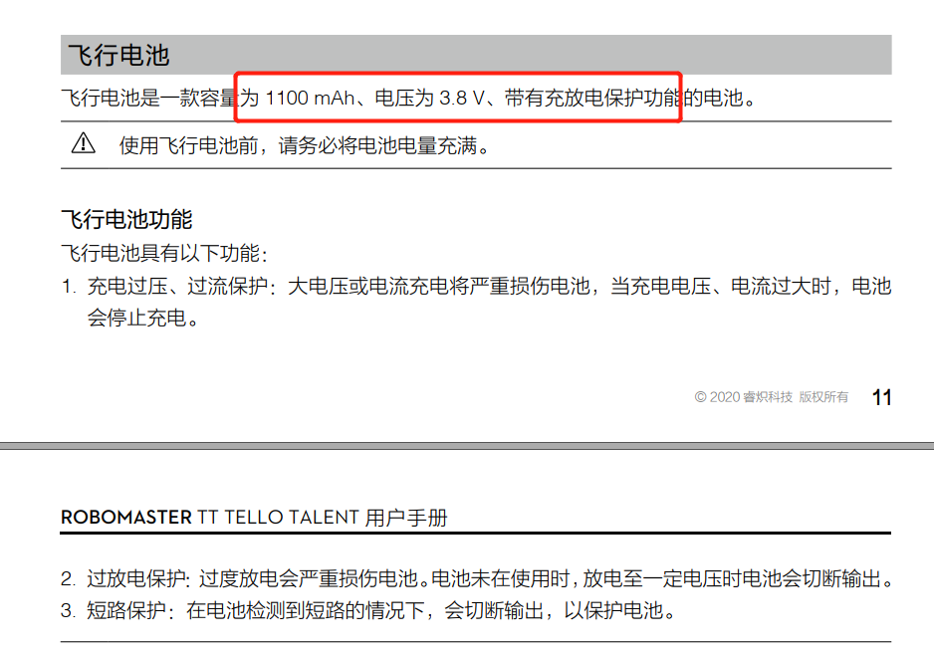

Slide 8
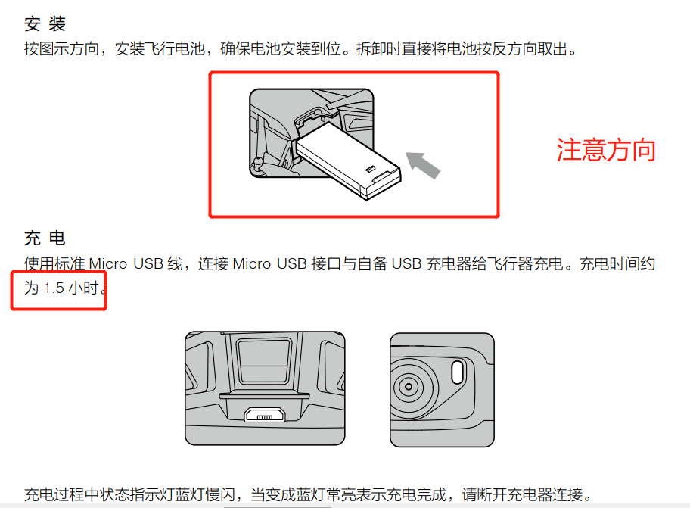
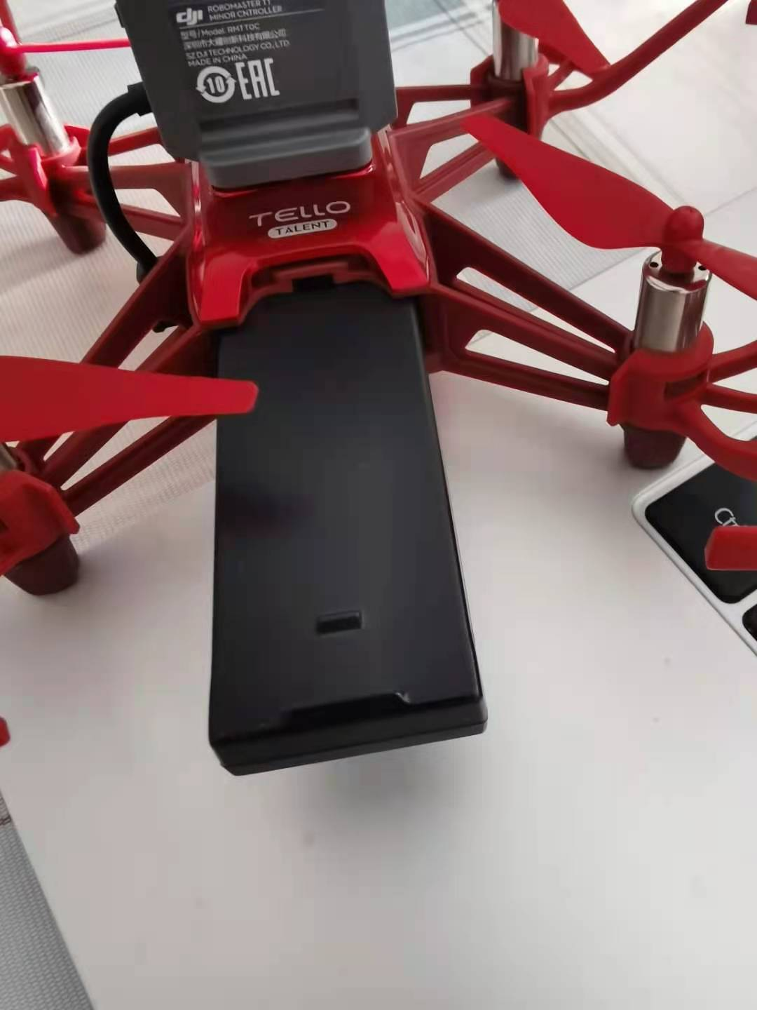
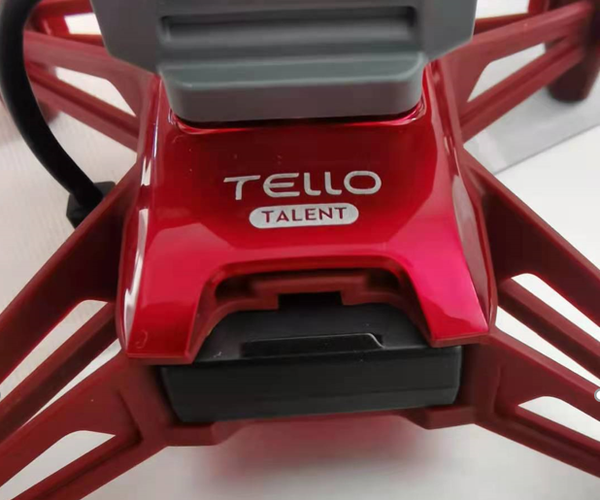

Slide 9
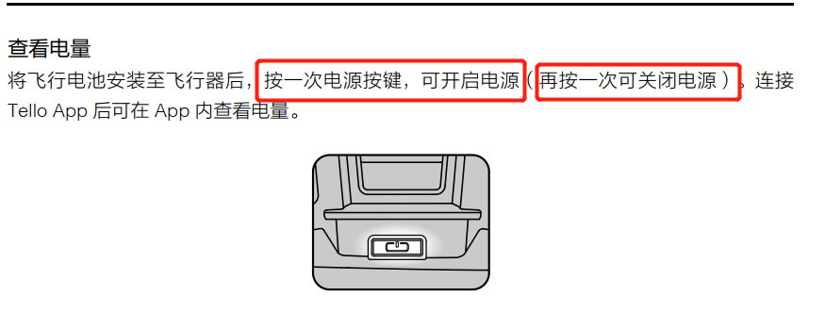

Slide 10
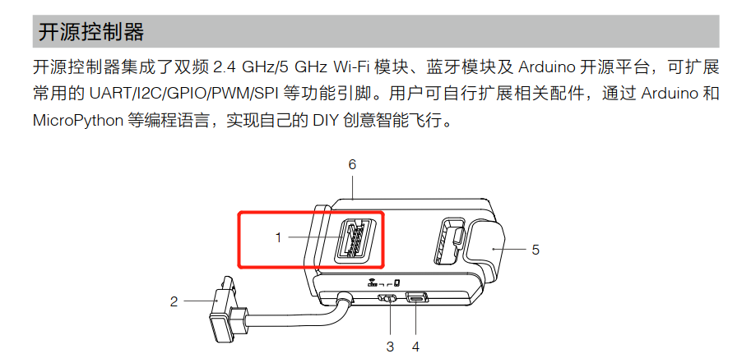
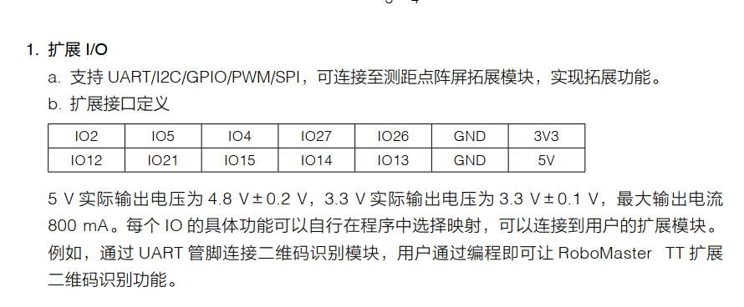

Slide 11
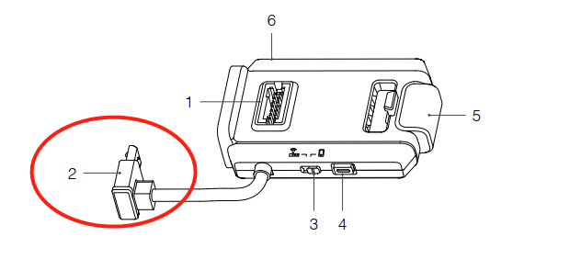
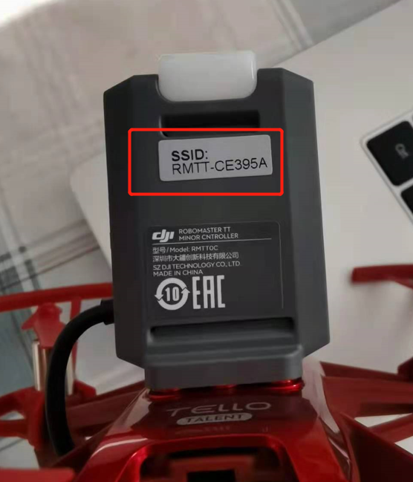
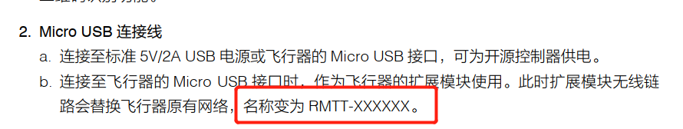

Slide 12
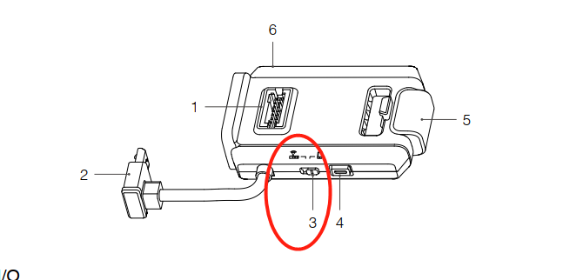
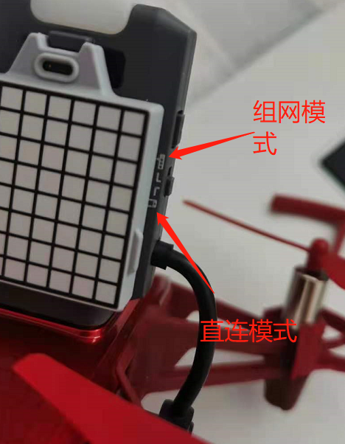
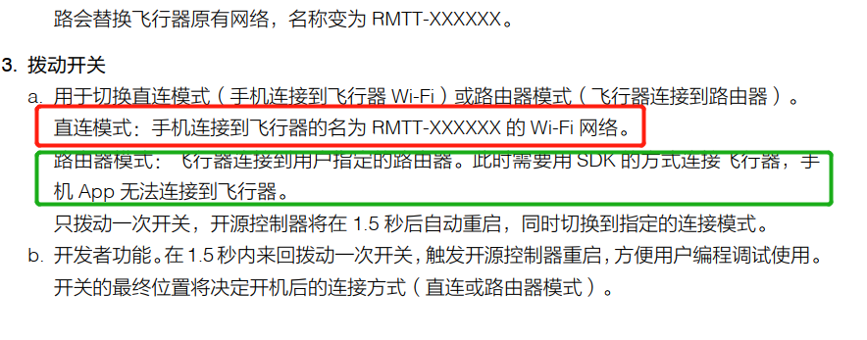

Slide 13
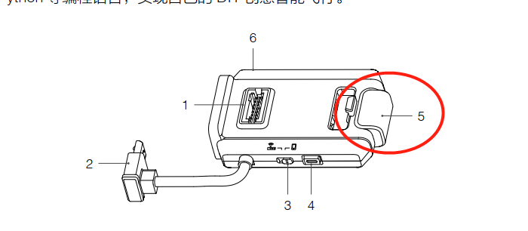
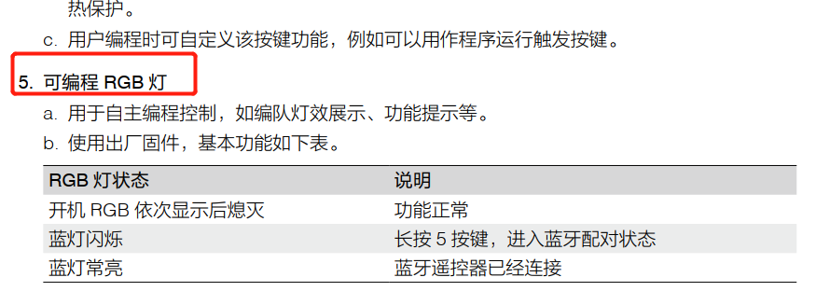

Slide 14
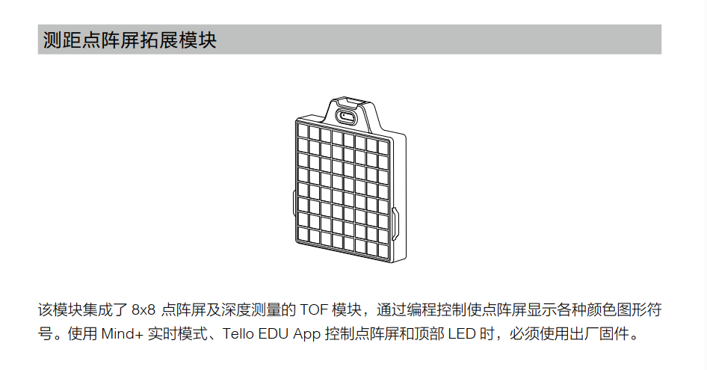

Slide 15
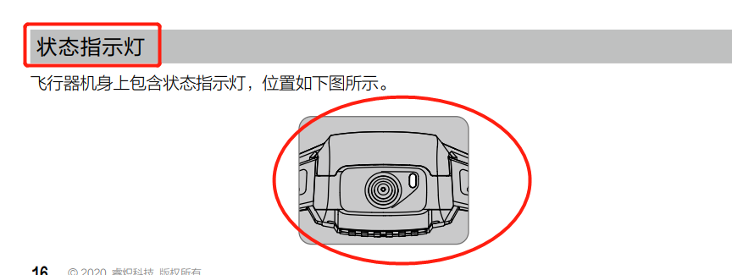
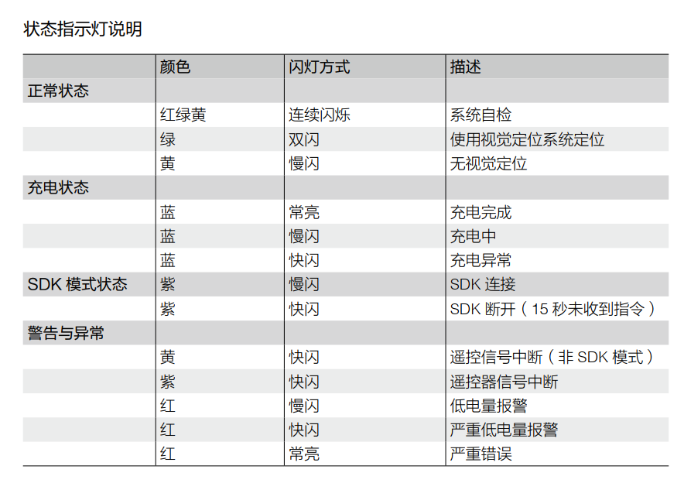

Slide 16
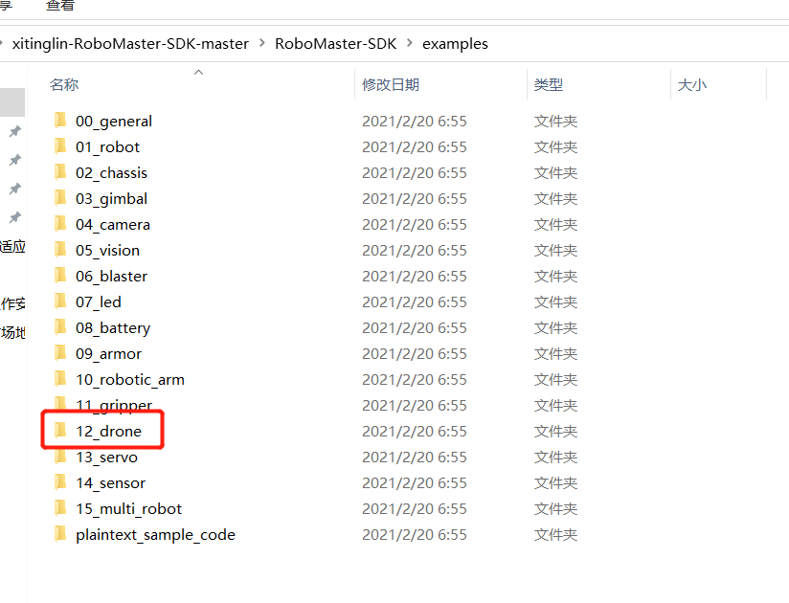
二、SDK介绍

Slide 17
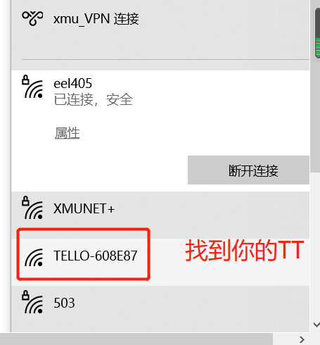
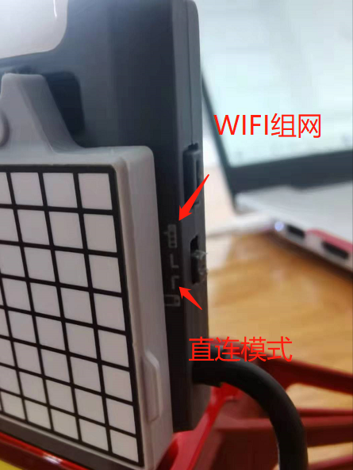
三、TT的直连模式
1、直连模式(直连模式后，你的电脑就不能上网啦！)

Slide 18
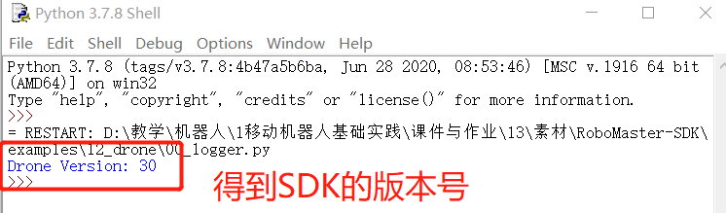
案例1：获取SDK版本号
1、直连模式
(1) 00_logger.py
import robomaster
from robomaster import robot
if __name__ == '__main__':
# 如果本地IP 自动获取不正确，手动指定本地IP地址
# robomaster.config.LOCAL_IP_STR = "192.168.10.22"
tl_drone = robot.Drone()
tl_drone.initialize()
# 获取飞机版本信息
version = tl_drone.get_sdk_version()
print("Drone Version: {0}".format(version))
tl_drone.close()

Slide 19
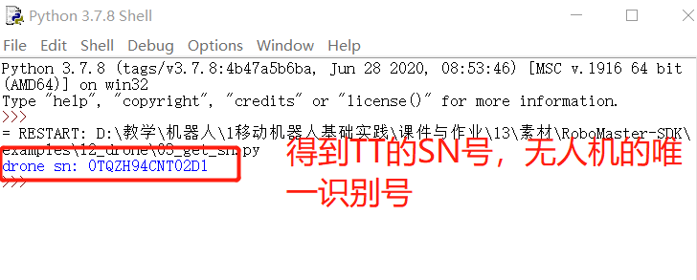
案例2：获取TELLO的sn号
import robomaster
from robomaster import robot
if __name__ == '__main__':
tl_drone = robot.Drone()
tl_drone.initialize()
# 获取飞机SN信息
SN = tl_drone.get_sn()
print("drone sn: {0}".format(SN))
tl_drone.close()
记下你的SN号，后面有用，重要！！！

Slide 20
案例3：无人机LED显示
if __name__ == '__main__':
mled_smile1 = '000000000r0000r0r0r00r0r000000000000000000r00r00000rr00000000000'
mled_smile2 = '00rrrr000r0000r0r0r00r0rr000000rr0r00r0rr00rr00r0r0000r000rrrr00'
tl_drone = robot.Drone()
tl_drone.initialize()
# 显示自定义图案
tl_drone.led.set_mled_graph(mled_smile1)
time.sleep(3)
tl_drone.led.set_mled_graph(mled_smile2)
time.sleep(3)
# 显示数字
for num in range(10):
tl_drone.led.set_mled_char('r', num)
time.sleep(0.5)
#接上面
# 显示字符A, B, C
tl_drone.led.set_mled_char(color='b', display_char='A')
time.sleep(3)
tl_drone.led.set_mled_char(color='b', display_char='B')
time.sleep(3)
tl_drone.led.set_mled_char(color='b', display_char='C')
time.sleep(3)
# 清屏
tl_drone.led.set_mled_char('0')
tl_drone.close()

Slide 21
案例3：无人机LED显示
效果显示

